Slide 1


Global and local imprints of climate forcings in temperature data: a statistical perspective
Jiří Mikšovský, Eva Holtanová, Petr Pišoft
Department of Atmospheric Physics
Faculty of Mathematics and Physics, Charles University, Prague
jiri@miksovsky.info
http://www.miksovsky.info/SantaFe2017.pptx

Slide 2

Charles University Prague
Temperature data:
Global and local time series
Climate forcings:
Internal & external
Statistical attribution analysis:
Principles, benefits, limitations
Imprints of climate forcings in temperature series:
Identification of influential predictors
Global vs. local effects
Inter-dataset contrasts
Transition to nonlinear techniques?
Deviations from linearity related to individual predictors
Spatial patterns of nonlinearity

Slide 3
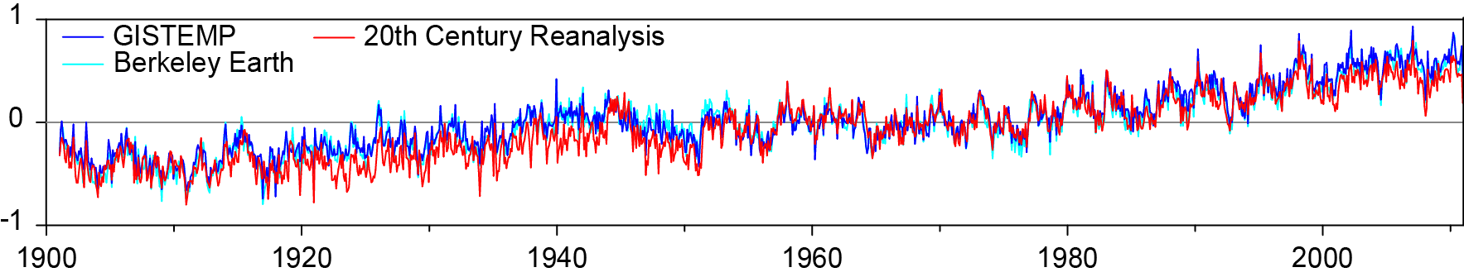
Charles University Prague
Temperature data:
Gridded temperatures & their global averages
Temperature analyses:
GISTEMP (NASA GISS)
Berkeley Earth (Berkeley Earth group)
Merged Land–Ocean Surface Temperature Analysis - MLOST (NOAA)
HadCRUT4 (CRU & Hadley Centre)
Reanalysis data:
20th Century Reanalysis (NOAA & CIRES)
How interchangeable are individual datasets?
How accurately do they represent the past evolution of the climate system?
Global temperature anomaly (°C, relative to 1951-1980): GISTEMP, Berkeley Earth and 20th Century Reanalysis

Slide 4
Statistical attribution analysis
Charles University Prague
Primary goal
Identification of components in the target signals associated with individual climate-forming agents
Key problems
Our analysis setup
Selection of suitable explanatory variables and their eventual pre-processing
Choice of the transfer function between predictands and predictor (basic type & specific architecture)
Evaluation of the resulting mappings, especially estimation of the statistical significance of the links
Multiple linear regression
Moving-block bootstrap and Monte Carlo-based techniques for estimation of statistical significance
Primary target period: 1901-2010
Monthly time scale

Slide 5
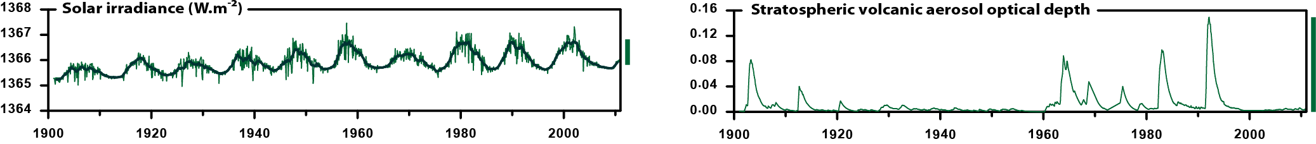
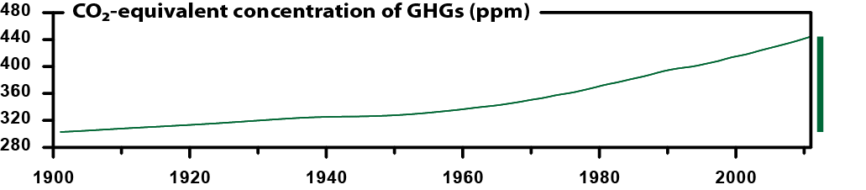
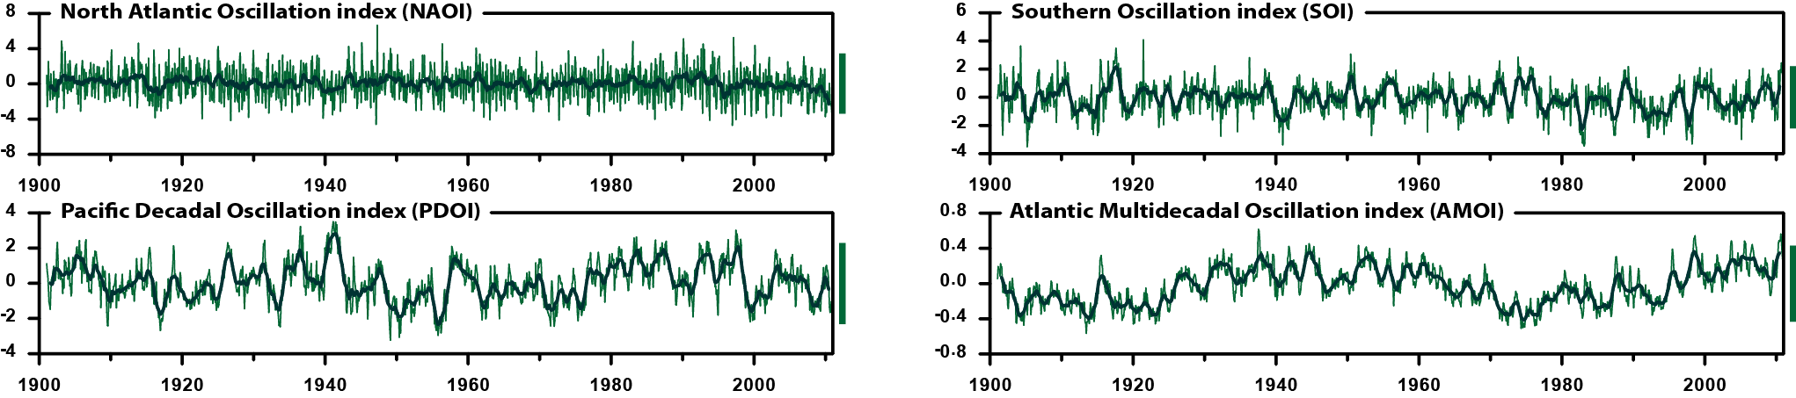
Explanatory variables:
Representatives of external and internal forcings
Charles University Prague
Natural external factors: Solar and volcanic activity
Atmospheric composition: Amounts of greenhouse gases (and aerosols)
Climatic oscillations: Internal modes of variability, diverse in origin and nature

Slide 6
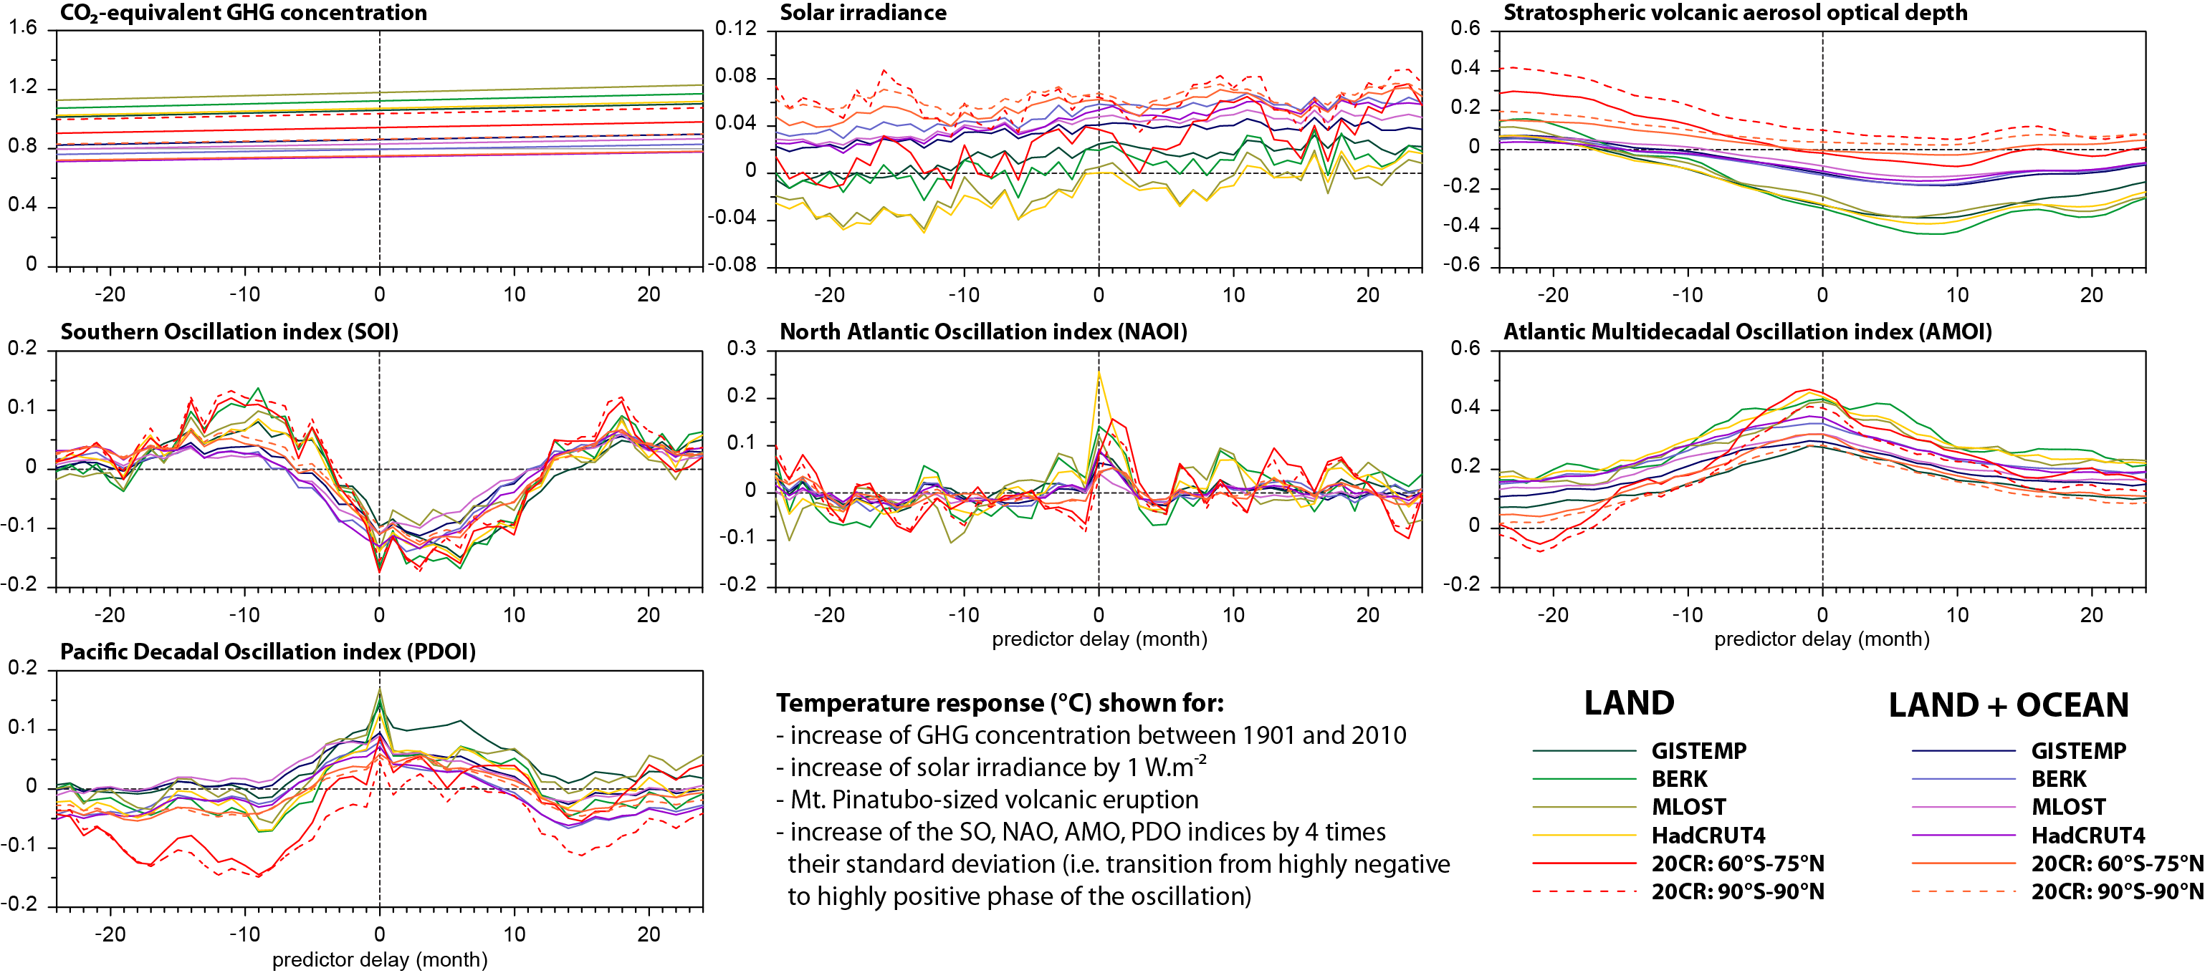
Delayed responses to predictors?
Global and global land temperature series
Charles University Prague
Global and global land temperature responses (°C), obtained by multiple linear regression with predictors shifted in time between -24 and +24 months (period 1901-2010)

Slide 7
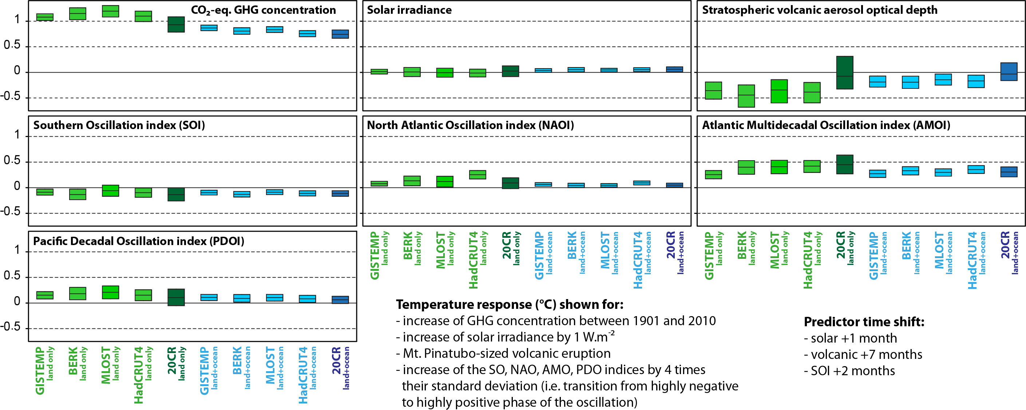
Statistical significance of the responses?
Global and global land temperature series
Charles University Prague
Global and global land temperature responses (°C) to individual predictors and their 99% confidence intervals (multiple linear regression & moving-block bootstrap, period 1901-2010)

Slide 8

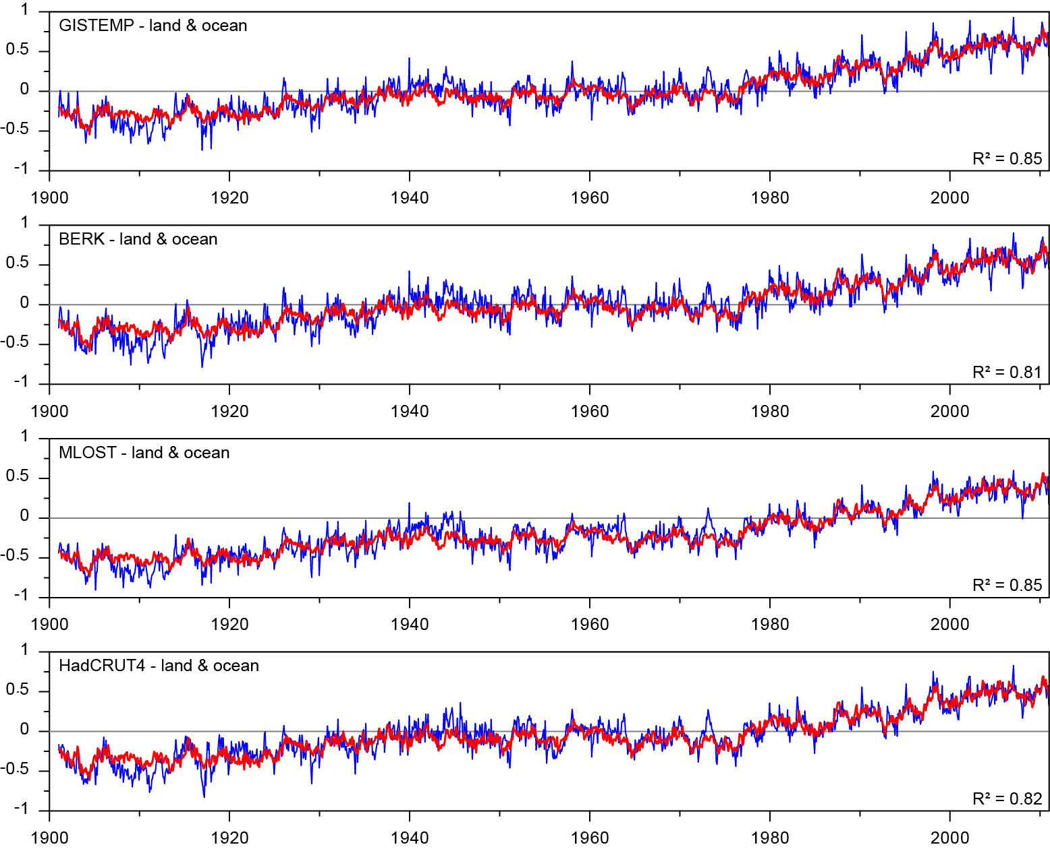
Global mean temperature:
Regression-extracted components
Charles University Prague
Anthropogenic component
Observed global temperature (°C) and its regression approximation
Solar activity
Volcanic activity
Oscillations Pacific (ENSO+PDO)
Oscillations Atlantic (AMO)
High-frequency oscillations (NAO+TPI)
Residual

Slide 9
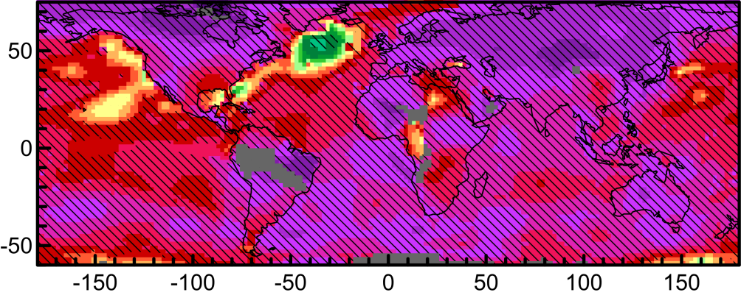
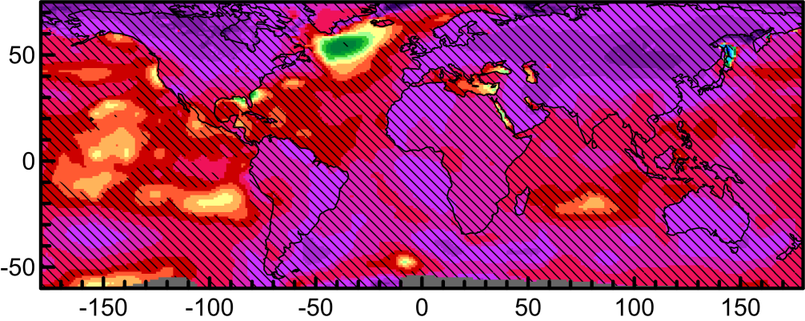
Temperature component related to:
GHG concentration
Charles University Prague
Mostly positive and strongly significant component, reflecting the presence of largely increasing long-term trends in the temperature series
Similar response pattern can also be obtained by using total anthropogenic forcing as the explanatory variable (due to high correlation of the respective predictors)
However, interpretation of the links as causal cannot be reliably done from the outcomes of statistical analysis alone
Temperature response (°C) to GHG concentration increase between 1901 and 2010
(hatching: response significant at the 99% level)
GISTEMP
Berkeley Earth
°E

Slide 10
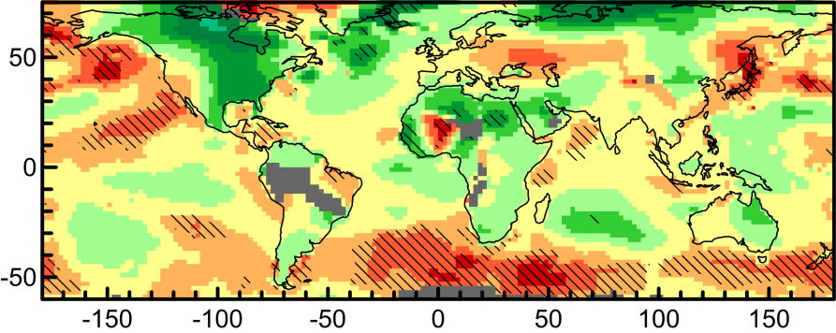
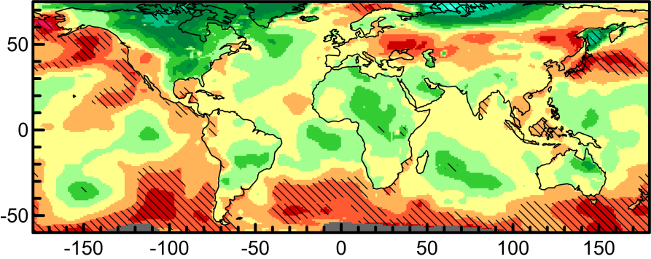
Temperature component related to:
Variations of solar activity
Charles University Prague
Significant temperature rise from increase of solar irradiance mostly limited to northern Pacific and southern seas
Patterns relatively stable in time: the solar-related components can also be detected for the second half of the 20th century, when direct aliasing with anthropogenic effects is negligible
Temperature response (°C) to total solar irradiance increase by 1 W.m⁻²
(hatching: response significant at the 99% level)
GISTEMP
Berkeley Earth
°E
°E

Slide 11
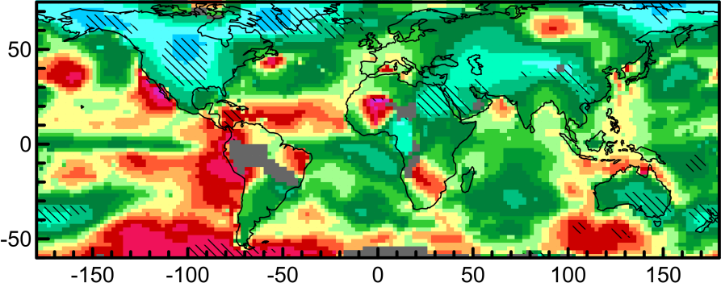
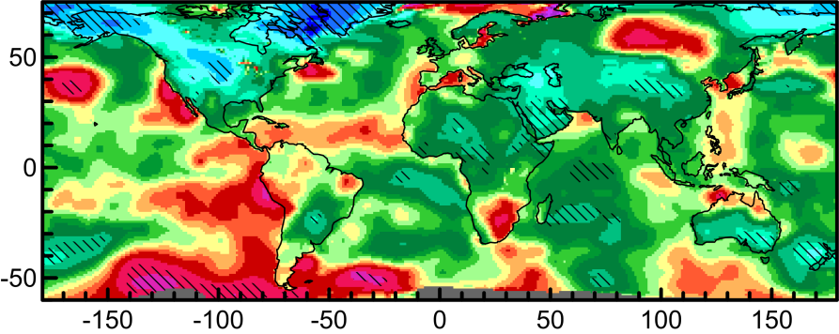
Temperature component related to:
Volcanic activity
Charles University Prague
In contrast to unambiguous cooling effects in global observational temperature series, local signatures of volcanic activity are less clear and rarely statistically significant
Distinct cooling was detected in a few regions over land (especially North America and Near East), but warming is also indicated in some (particularly oceanic) areas
Relative rarity of major volcanic events complicates analysis of potential aliasing effects
Temperature response (°C) to Mt. Pinatubo-sized volcanic eruption
(hatching: response significant at the 99% level)
GISTEMP
Berkeley Earth

Slide 12
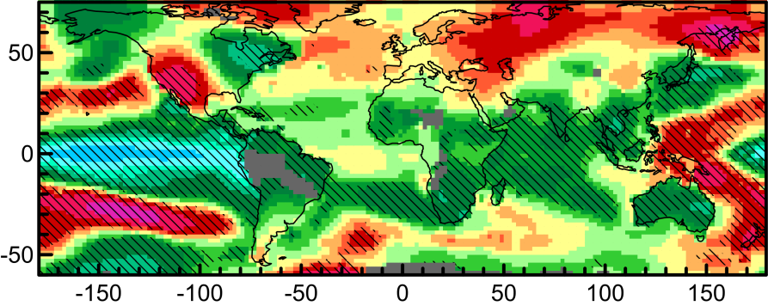
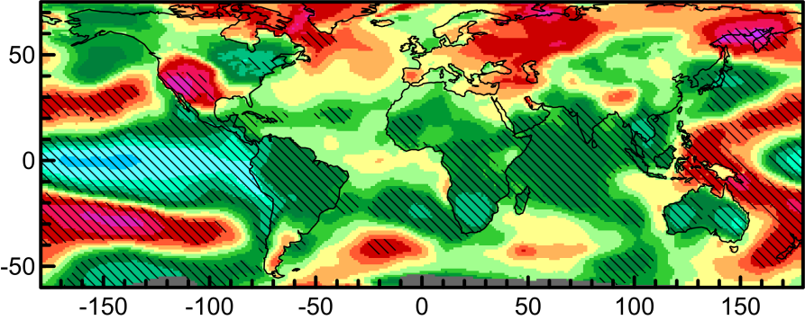
Temperature component related to:
Southern Oscillation
Charles University Prague
Canonical pattern in the Pacific, along with significant teleconnections extending to much of the tropics and several regions in higher latitudes
Distinct effect on global temperature, due to prevalence of negative responses worldwide
Temperature response (°C) to Southern Oscillation index increase by 4x its standard deviation
(hatching: response significant at the 99% level)
GISTEMP
Berkeley Earth

Slide 13
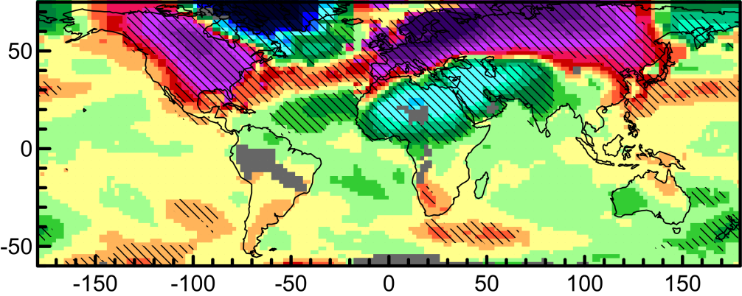
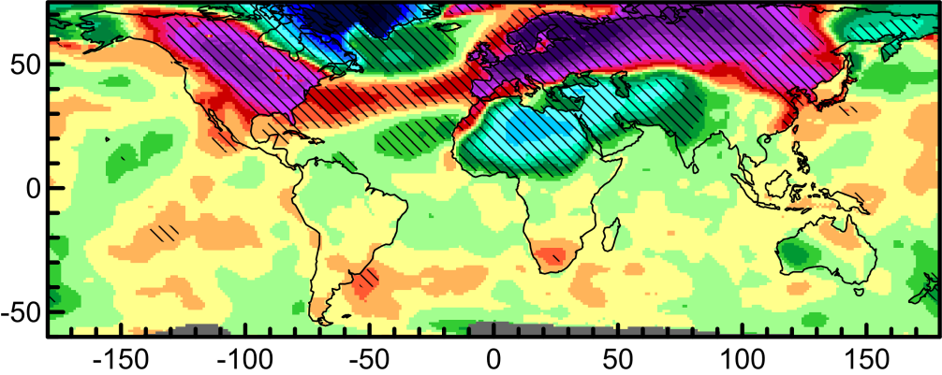
Temperature component related to:
North Atlantic Oscillation
Charles University Prague
Local temperature links to NAO detectable over much of the northern hemisphere, from western Canada to eastern Asia
Contributions from areas with positive and negative temperature contributions cancel out mutually and almost negate NAO-related component in global temperature
NAO's fast variability compared to other oscillatory modes results in limited effect on mid- to long-term temperature trends
Temperature response (°C) to North Atlantic Oscillation index increase by 4x its standard deviation
(hatching: response significant at the 99% level)
GISTEMP
Berkeley Earth

Slide 14
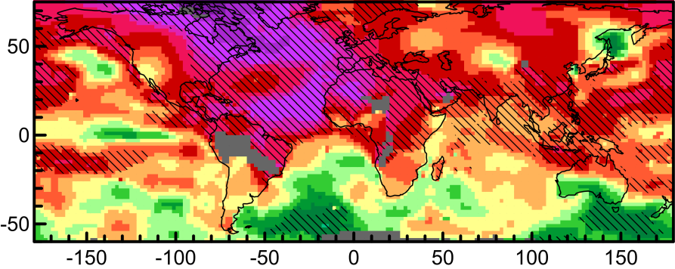
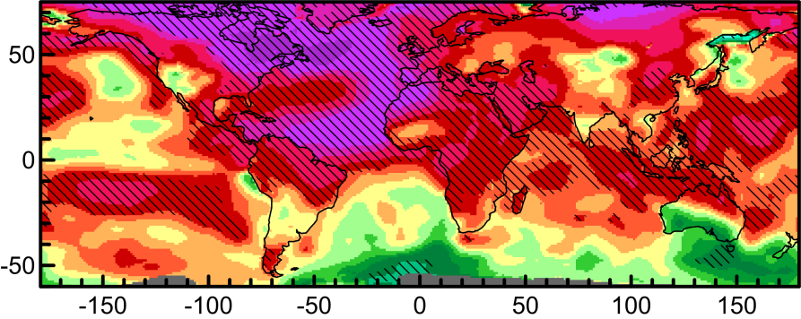
Temperature component related to:
Atlantic Multidecadal Oscillation
Charles University Prague
Due to AMO index definition, strong positive correlations exist with temperatures in all of northern Atlantic
Moreover, predominantly positive and often significant links also extend to many other areas of the globe, combining in a strong AMO-related component in global temperatures
The response pattern is quite stable in time, though this does not directly prove stability of AMO itself
Temperature response (°C) to Atlantic Multidecadal Oscillation index increase by 4x its standard deviation
(hatching: response significant at the 99% level)
GISTEMP
Berkeley Earth
°E

Slide 15
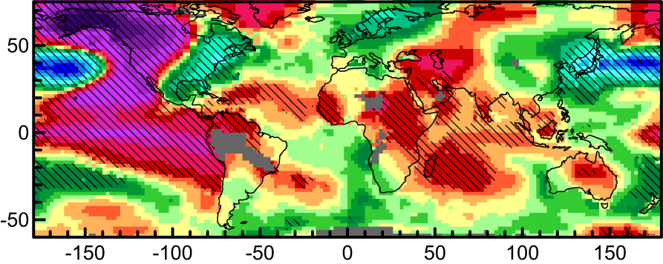
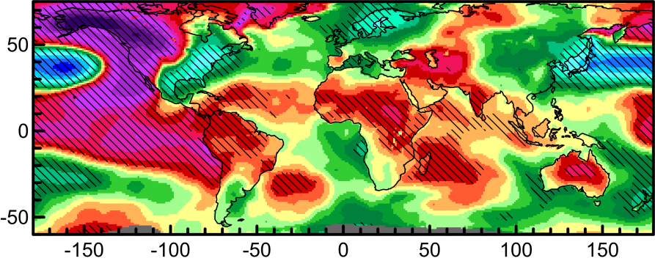
Temperature component related to:
Pacific Decadal Oscillation
Charles University Prague
Primary area of influence in northern Pacific, in line with PDO's definition from sea surface temperatures
Significant teleconnections extend across the globe, including Africa or northern Europe
PDO's link to SO/ENSO, both physical and statistical, results in relation of their respective response patterns
Temperature response (°C) to Pacific Decadal Oscillation index increase by 4x its standard deviation
(hatching: response significant at the 99% level)
GISTEMP
Berkeley Earth

Slide 16
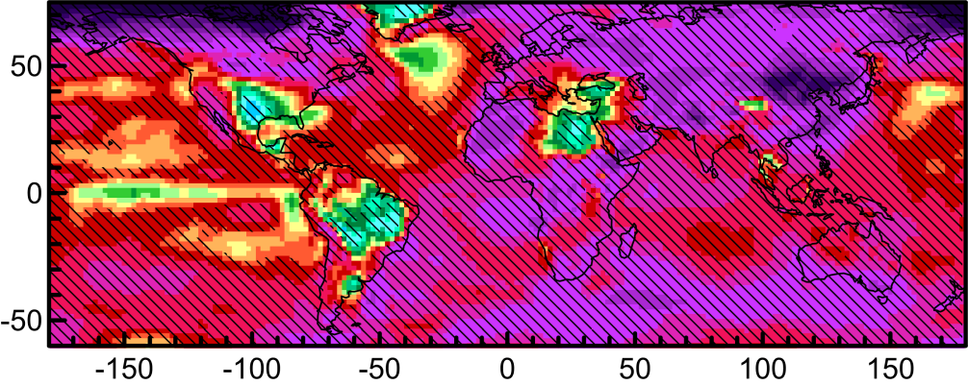
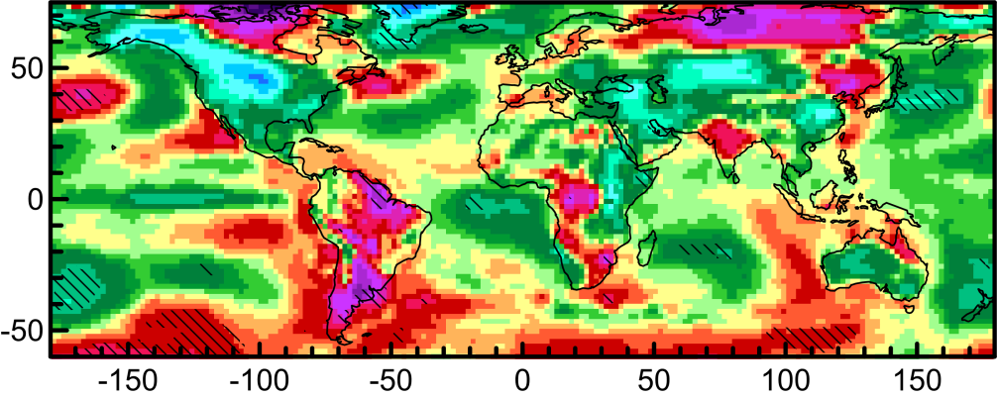
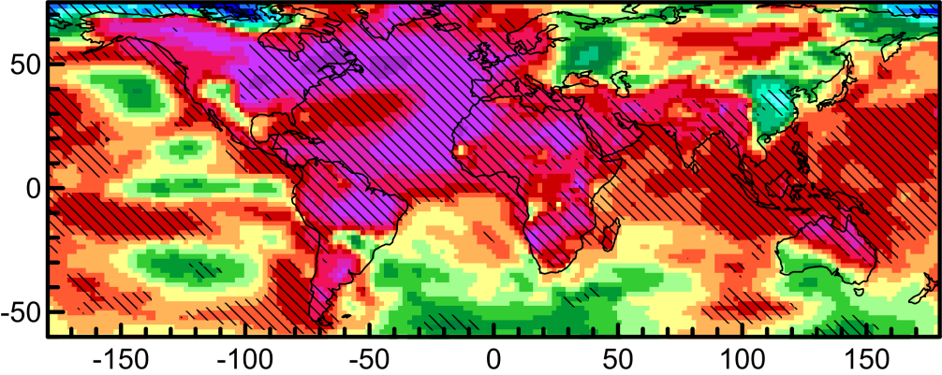
20th Century Reanalysis specifics:
Temperature responses compared to GISTEMP
Charles University Prague
GISTEMP
20th Century Reanalysis
GHGs
Volcanic activity
AMO

Slide 17
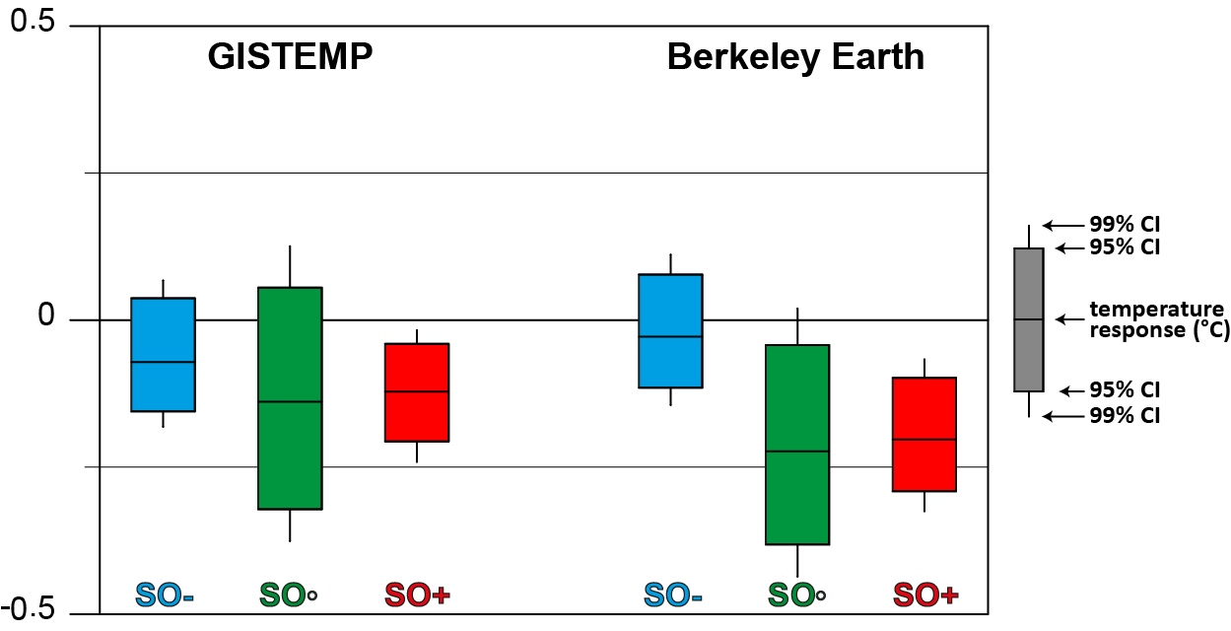
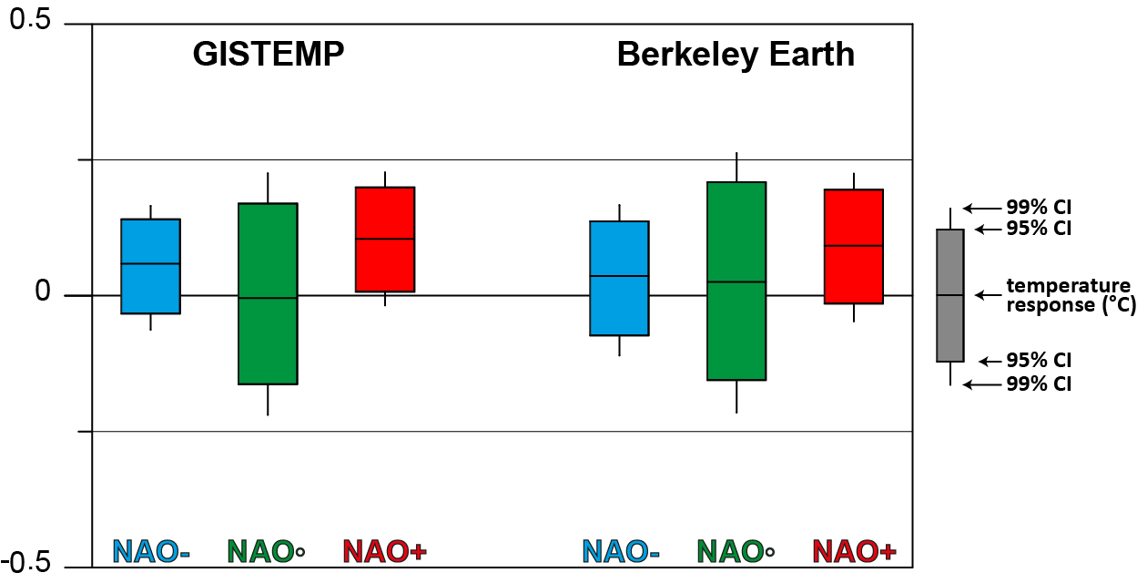
Linear approach:
How justified is it?
Charles University Prague
Complex nonlinear mappings (such as multilayer perceptron neural networks) bring just limited improvement in terms of total variance explained by attribution mappings
However, deviations from strict linearity can manifest more clearly for responses related to specific predictors
SO/NAO-related global temperature responses (°C), based on regression coefficients calculated separately for the respective index in positive (SO+/NAO+), neutral (SO◦/ NAO◦) or negative (SO-/NAO-) phase

Slide 18
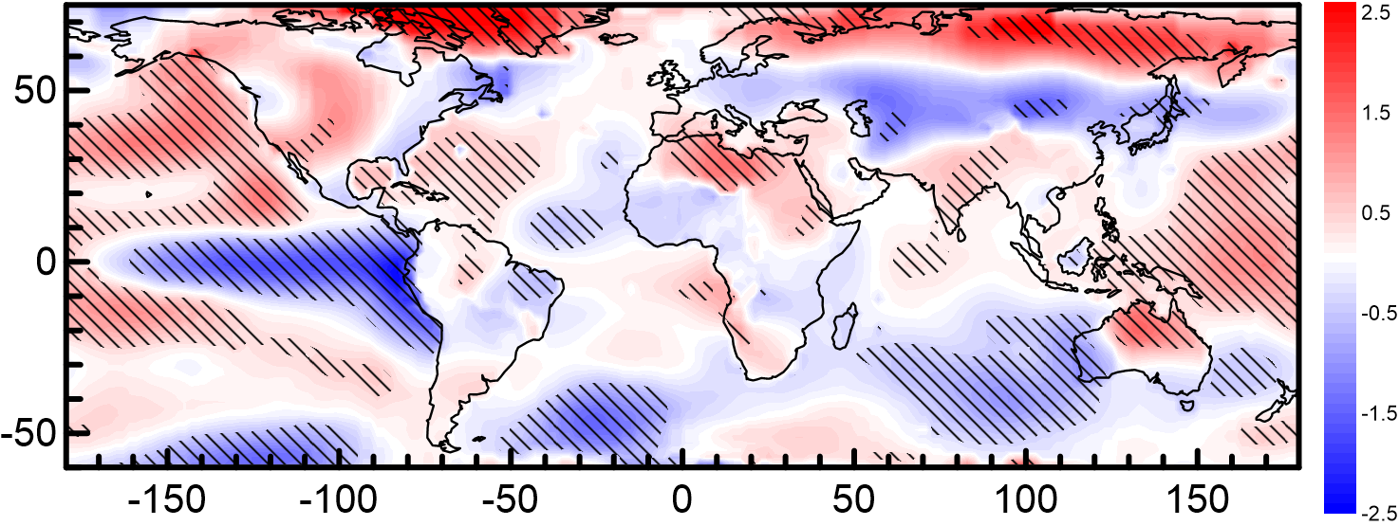
Deviations from linearity:
Southern Oscillation imprint in temperature
Charles University Prague
Strong indications of nonlinearity in the Pacific and for some of the teleconnections
Individual character of responses for different SO phases may obscure its effect in the undivided data
Difference (°C) between temperature responses to Southern Oscillation index calculated for the SO- and SO+ phases
(hatching: differences exceeding 2x standard deviation of the response estimates)
18

Slide 19
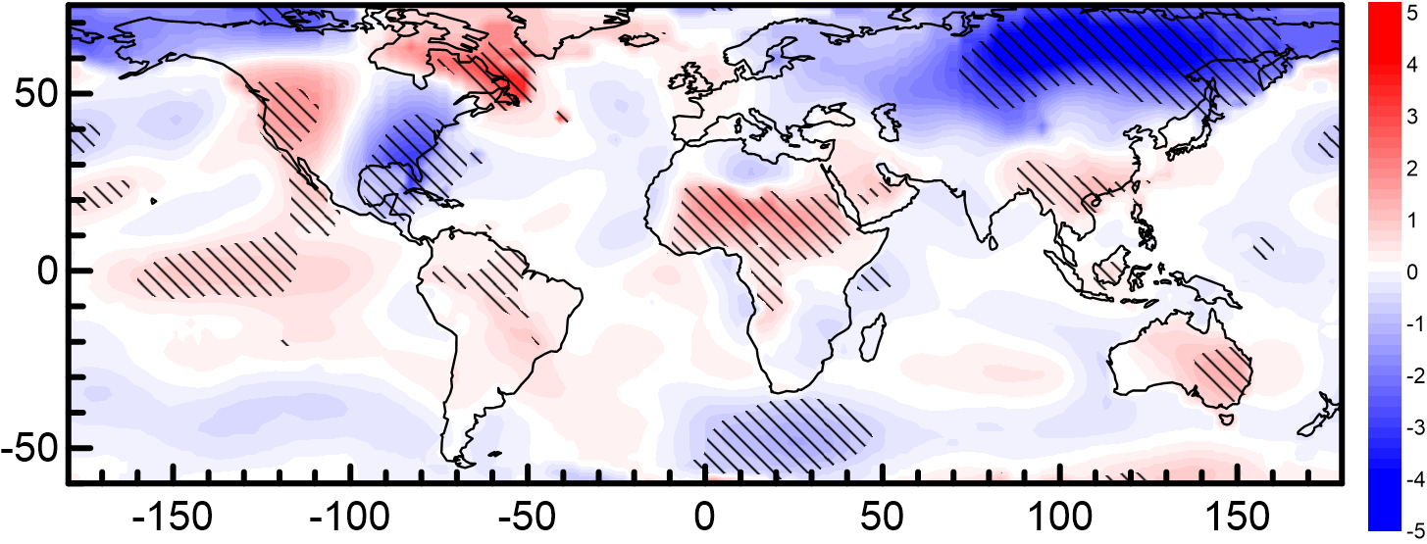
Deviations from linearity:
North Atlantic Oscillation imprint in temperature
Charles University Prague
Linear approach justified quite well in most of Europe and Atlantic, but less appropriate in some regions further from the center of NAO's influence (namely east coast of north America, sub-Saharan Africa, Siberia)
Difference (°C) between temperature responses to North Atlantic Osc. index calculated for the NAO- and NAO+ phases
(hatching: differences exceeding 2x standard deviation of the response estimates)

Slide 20
Summary
Charles University Prague
Combination of predictors representing anthropogenic forcing, volcanic activity and selected internal climate variability modes provides a good approximation of mid- to long-term global temperature variability
The fraction of temperature variance explained by the regression mappings is generally lower at local scales; some of the factors influential for global averages are less prominently expressed locally (volcanic effects); some distinct regional signals are suppressed by global averaging (North Atlantic Oscillation)
Temperatures available from the 20th Century Reanalysis share many features with their observational counterparts, but there are also marked differences, particularly in magnitude of local long-term trends, effects of volcanic activity and some of the teleconnections over continents
Deviations from linearity are rather limited for global temperature series, but can be profound locally; specific forms of nonlinearity do differ between various locations and forcing factors

Slide 21
Thank you for your attention
Charles University Prague
http://www.miksovsky.info/SantaFe2017.pptx

Slide 22
Related sources:
Charles University Prague
Mikšovský J., Holtanová E., Pišoft P. (2016): Imprints of climate forcings in global gridded temperature data, Earth Syst. Dynam. 7:231-249, doi:10.5194/esd-7-231-2016
Mikšovský J., Pišoft P. (2015): Attribution of European temperature variability during 1882–2010: A statistical perspective. In: Urban O. et al. (eds.): Global Change: A Complex Challenge. Global Change Research Centre, The Czech Academy of Sciences, Brno, p. 10-13. ISBN: 978-80-87902-10-3
Mikšovský J., Brázdil R., Štěpánek P., Zahradníček P., Pišoft P. (2014): Long-term variability of temperature and precipitation in the Czech Lands: an attribution analysis. Clim. Change 125(2):253-264, doi: 10.1007/s10584-014-1147-7

